Slide 1
CLC 3
Ryan Coon Allen Atkins Carrie Assalone

Slide 2
Recursion Trees
Recursion Tree Method is a pictorial representation of an iteration method which is in the form of a tree where at each level nodes are expanded.
In general, we consider the second term in recurrence as root.
It is useful when the divide & Conquer algorithm is used.
It is sometimes difficult to produce a good guess. In Recursion tree, each root and child represents the cost of a single subproblem.
We sum the costs within each of the levels of the tree to obtain a set of pre-level costs and then sum all pre-level costs to determine the total cost of all levels of the recursion.
A Recursion Tree is best used to generate a good guess, which can be verified by the Substitution Method.

Slide 3
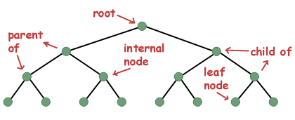
Parts of a tree

Slide 4
Three of most common ways to traverse a tree are known as in-order, pre-order, and post-order.
An in-order traversal visits each of the nodes in order
In a preorder traversal, we first print ourself, then we print all the nodes to the left of us, and then we print all the nodes to the right of ourself.
In a post-order traversal, we visit everything to the left of us, then everything to the right of us, and then finally ourself.

Slide 5
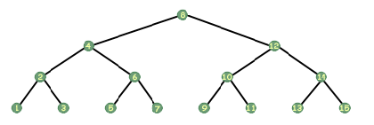
It may seem that the in-order traversal would be difficult to implement. However, using recursion it can be done in four lines of code.
void print_inorder(tree_t *tree) { if (tree!=NULL) { print_inorder(tree->left); printf("%d\n", tree->data); print_inorder(tree->right); } }

Slide 6
Trace Recursive Algorithms

Slide 7
Trace Recursive Algorithms

Slide 8
Trace Recursive Algorithms

Slide 9
Sorting Algorithm

Slide 10
Sorting Algorithm

Slide 11
Sorting Algorithm

